Slide 1
Preparing a New Generation of Illinois Fruit and Vegetable Farmers a USDA NIFA Beginning Farmer and Rancher Development Program Project Grant # 2012-49400-19565 http://www.newillinoisfarmers.org
Notes:
The following presentation was part of a beginning farmer course, “Preparing a New Generation of Illinois Fruit and Vegetable Farmers,” offered by the University of Illinois and the Illinois Migrant Council from 2012 through 2015. This course was funded by the United States Department of Agriculture’s National Institute of Food and Agriculture, and specifically by the Beginning Farmer and Rancher Development Program. For more information about the program and for links to presentations and resources on many other topics, see the website newillinoisfarmers.org.

Slide 2
Preparing a New Generation of Illinois Fruit and Vegetable Farmers Evaluating and Selecting Cultivars
Elizabeth Wahle & Jeff Kindhart
Notes:
Welcome to Evaluating and Selecting Cultivars. This is an introductory learning module focusing on the basic considerations for selecting cultivars to grow.

Slide 3
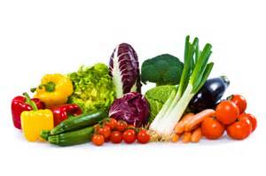
Objectives …
Understand why crop, variety, and cultivar selection is important
Know where to find information on the performance of specific varieties and cultivars
Examine a few examples of important traits of specific varieties or cultivars
Know how to evaluate crop performance on your farm
Notes:
Selection of crops and specific varieties (or cultivars) that match site, production system, and markets is one of the most important decisions a commercial fruit and vegetable grower must make. In this module, you will learn how to suit your growing conditions and market potential to the appropriate cultivar selection. Also discussed will be resources for additional information on cultivars and how to conduct your own cultivar evaluation.

Slide 4
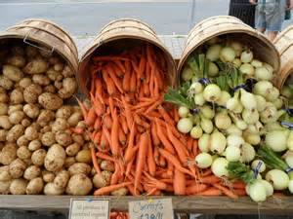
Before you select crops and specific varieties or cultivars, remember that you can’t grow everything…
Grow what you have a market for … or what you think you can develop a market for.
Grow what fits in your succession plan.
Grow what fits in your space.
Grow what thrives in your particular environment.
“If you cant sell it, don’t grow it.”
Notes:
Every farmer has to decide what to produce, and two fundamental rules for long-term survival are selling quality, and finding your niche. Before you plant anything, you should research your potential market. It is important to understand what crops are already being produced, in what quantity and how they are being marketed in your area--and how your enterprise will affect and hopefully enhance that market. Remember, you do not need to grow everything you sell—but what you grow has to sell and be profitable. With the right products, customers and skills, success can be found in locating niche markets and developing new products to satisfy them.

Slide 5
Variety
Plants that differ from other members of the species in minor ways
Appears naturally with no human intervention
Name is in Latin and follows the species name
Commonly left out of catalogue listing
Though not technically correct, is used interchangeably with cultivar
Notes:
Let’s start with some terminology. Variety is a term that today is used interchangeably with cultivar, but is not technically correct. Plant varieties are changes or differences in a plant species that occur in nature, through cross-pollination, mutation and adaptation—not controlled breeding by humans

Slide 6
Good example of variety
Leaves
Brassica oleracea acephala - kale, collards
Brassica oleracea alboglabra - Chinese broccoli
Terminal bud
Brassica oleracea capitata – red and green cabbage
Brassica oleracea sabauda - savoy cabbage
Axillary (lateral) buds
Brassica oleracea gemmifera - Brussels sprouts
Stem
Brassica oleracea gongylodes - kohlrabi
Inflorescences
Brassica oleracea botrytis - cauliflower
Brassica oleracea italica – broccoli
Notes:
Brassica oleracea provides a good example of variety. The wild plant is a small biennial herb from the coastal Mediterranean region--overwintering as a rosette of leaves before producing a spike of a few yellow flowers at the end of its second summer before dying. Over the last several thousand years, several distinct lineages of Brassica oleracea have developed, each amplifying different parts of this wild plant to produce several vegetable varieties. For example: the leaves of kale, collard greens, and Chinese broccoli, the terminal bud in cabbage, the axillary (lateral) buds in Brussels sprouts, the stem in kohlrabi and the flowers in broccoli and cauliflower. These varieties look dramatically different but are nonetheless considered to be the same species.
As an additional note: catalogs will often use the term “group” when referencing a variety name. So instead of a crop grouping that reads Brassica oleracea italica, the heading would read “broccoli” or “Italica group.”

Slide 7
Another example of variety
Zea mays amylacea - flour corn
Zea mays everta - popcorn
Zea mays indentata - dent corn
Zea mays rugosa and Zea mays saccharata - sweet corn
Zea mays ceratina - waxy corn
Zea mays tunicata - pod corn
Zea mays indurata – flint corn
Zea mays japonica - Striped maize
Notes:
Like Brassica oleracea, Zea mays is another plant species with a number of distinct varieties. Rather than amplification of certain plant structures as seen in Brassica oleracea, the varieties of Zea mays differ mainly in the amount of starch each kernel contains.

Slide 8
Cultivar
Cultivated variety = Cultivar
Human intervention (selective breeding)
Non-Latin name
Name follows species or variety name
Capitalized and in single quotes
Example
Zea mays rugosa ‘Ambrosia’
Zea mays rugosa ‘Silver King’
Zea mays rugosa ‘Mirai’
Notes:
The term cultivar is a contraction of cultivated variety, meaning that humans selected the parents and made controlled crosses. Cultivar names are not italicized like variety names, but they are capitalized like a proper name. The are also bracketed with single quotes and follow directly after the species and/or variety name. Using the sweet corn example on this slide, we already know that sweet corn is a variety of Zea mays, designated by the variety name rugosa. But it is the cultivar name that follows that differentiates the type of sweet corn.

Slide 9
Open Pollination
An open-pollinated plant cultivar is one in which pollination is carried out by wind, insects, or other naturally occurring agents
The seed saved from an open-pollinated cultivar can be grown in subsequent years and will breed true providing that it does not cross-pollinate with another cultivar of the same variety or species.
Notes:
As mentioned in the Basic Fruit Production module, some plants are self-fruitful, and some are self-unfruitful—terms used to describe whether a plant can self-pollinate or whether it needs to be cross pollinated by another species or cultivar for fertilization to occur. We also need terms to describe how pollination is going to occur. An open-pollinated plant is one in which pollination is carried out by wind, insects, or other naturally occurring agents. The seed saved from an open-pollinated cultivar can be grown in subsequent years and will breed true providing that it does not cross-pollinate with another cultivar of the same variety or species. Catalogues designate open pollinated seed with an OP somewhere near the name or in the description. The converse of an open pollinated cultivar is a hybrid cultivar, which will be discussed shortly.

Slide 10
A Hybrid cultivar (i.e controlled pollination)
Is made by cross-pollinating two specific parent varieties/cultivars
This first generation of offspring is referred to as the F1 hybrid
Although F1 hybrids often show increased yield and vigor, the plants will not breed true if its seeds are saved
F1 Hybrids include many kinds of sweet corn, summer squash, melons, cucumbers, carrots, spinach and some tomatoes and peppers
Notes:
Cultivar names followed by the descriptor F1 designates that seed as hybrid seed. F1 (or 1st Generation) does not mean genetically modified organism (or GMO), but instead refers to resulting seed made by cross-pollinating two specific parent varieties/cultivars. Although F1 hybrids often show increased yield and vigor, the plants will not breed true if its seeds are saved.

Slide 11
Heirloom
Open pollinated
Often older cultivars
passed along from generation to generation
Often chosen for flavor
Most are disease-susceptible
‘Sainte Lucie,’ 85 days, late-season, indeterminate, open pollinated
Notes:
Although there is no exact cutoff date, heirlooms in general are cultivars that have been in existence since before modern breeding or the development of hybrids—usually before the mid-1950’s. The seed of these open pollinated crops have been saved for generations by growers and passed down through the ages—often with a family history or story. Although heirlooms do not in general provide the high yields, consistency and disease resistance of hybrids, they do excel in a grand variety of flavors, colors, shapes, and textures. Although “heirloom” is a term generally associated with crops produced from seed, it and the term “antique” are also applied to older cultivars of perennial plant material. For example, ‘Latham’ is considered an heirloom raspberry cultivar. The cross for Latham was made in 1908 at the University of Minnesota Fruit Breeding Farm, selected for evaluation in 1914 and introduced to the market in 1920.

Slide 12
Genetically modified organisms (GMO)
A variety of methods used to genetically modify organisms or influence their growth and development by means that are not possible under natural conditions or processes and are not considered compatible with organic production
Such methods include cell fusion, microencapsulation and macroencapsulation, and recombinant DNA technology (including gene deletion, gene doubling, introducing a foreign gene, and changing the positions of genes when achieved by recombinant DNA technology)
Such methods do not include the use of traditional breeding, conjugation, fermentation, hybridization, in vitro fertilization, or tissue culture.
Notes:
Genetically modified organism, also known as GMO’s, are not allowed in certified organic production. It should also be noted that not all marketing outlets or customers are accepting of GMO crops—know before you grow! GMO’s are created using a variety of methods to genetically modify or influence their growth and development by means that are not possible under natural conditions or processes. Such methods include cell fusion, micro- and macroencapsulation, and recombinant DNA technology. Recombinant DNA technology can include gene deletion, gene doubling, introducing a foreign gene, and changing the positions of genes when achieved by recombinant DNA technology. As mentioned before, GMO’S do not include cultivars resulting from traditional breeding, conjugation, fermentation, hybridization, in vitro fertilization, or tissue culture. For example, scab resistant apple cultivars came about through traditional breeding and are acceptable for organic production. Sweet corn cultivars containing the Bt protein though, are not allowed in organic production because recombinant DNA technology was used to insert the Bt protein found in Bacillus thuringiensis (Bt) to protect the sweet corn from certain damaging insects.

Slide 13
Cultivars within a crop differ in …
Response to environment
Growth habit, fruit shape
Overall yield
Maturity
Color
Flavor and nutritional value
Disease and insect resistance
Post-harvest stability
Market niche
Profit potential
Notes:
Using tomato as an example, let me demonstrate how choosing your cultivar is an important decision. Response to environment can be viewed more than one way—it can refer to your production system or when in the season you are growing the crop. Tomatoes are a warm season crop and for the most part are traditionally grown outside after all danger of frost. But we have numerous systems for season extension, including hot caps, caterpillar tunnels, low tunnels, high tunnels, greenhouses. And for each of these production systems, certain cultivars are more suitable.
Tomatoes have two predominant growth habits—indeterminate and determinate. Almost all heirloom tomatoes are indeterminate growth, also referred to as vining types, meaning they continue to grow and set flower buds until frost kills them, sometimes achieving heights of over 10 feet tall. The newer cultivars tend to be determinate in growth, meaning they are shorter in overall height—usually 3-5 feet tall and they tend to produce a crop in a much narrower window than vining types—usually 2-3 weeks. Determinate types are also referred to as bush types.
Overall yield is a major factor but there are other facets that must be considered. Let’s compare two tomato cultivars. Both average 40 lbs per plant, but one cultivar tends to produce a more uniform crop of large fruit. The other cultivar produces a larger number of fruit but there is no uniformity—size ranges from small to large. Depending on your market needs, one cultivar may be more desirable over the other even though they produce the same overall yield.
Tomatoes are usually grouped by maturity or days to harvest. Early-season cultivars are usually much smaller plants and are more cold tolerant than later season cultivars, but they lack the full bodied flavor and size and quality of later season cultivars. Main-season tomatoes are the work horses—usually the most reliable and productive. Late-season tomatoes are usually very large—like the beefsteaks, but have the disadvantage of their overall long growing season.
Tomatoes come in a rainbow of colors but red is still king, although some markets have a strong demand for other colors like yellow, pink, purple, orange, white and black. And along with an attractive fruit, other characteristics like improved flavor and nutritional value are important marketing considerations.
One of the drawbacks to growing heirloom tomatoes is their lack of resistance to Fusarium wilt and Verticillium wilt, two very common and destructive soil borne diseases. We now have a solution for this problem in several vegetable crops by grafting susceptible plants to a resistant rootstock. Most modern tomato cultivars though have resistance bred into them through traditional breeding practices. A note that resistance does not mean plants are immune, but simply that they are less likely to succumb to specific disorders than a non-resistant variety. The take home message is to select cultivars that have the best disease and insect resistance package available for your production system.
Post-harvest stability isn’t something most growers think about until it is too late. In the case of tomatoes, they differ widely on shelf life, depending mainly on the thickness of the outer skin. ‘Cherokee Purple’ is an heirloom tomato that has a beautiful purple-black fruit with an almost smoky tomato flavor, but it has a relatively thin skin that is easily damaged and a shorter shelf life. As another example, yellow raspberries are relatively delicate compared to other raspberries and fetch a premium to offset the added care and risk a grower takes to grow them.
Put this all together when selecting cultivars and you hopefully have found your niche market. As you will hear repeatedly, continue to evaluate each crop for it’s contribution to your bottom line and make changes when a cultivar is failing to fill your market needs.

Slide 14
Response to environment
Cold-hardiness
Contender peaches; Illini Hardy blackberries
Differences in sweet corn vigor re: early planting
Seasonality
Day-neutral versus “June-bearing” strawberries
Ability to stand up to summer heat and humidity
Cherries, pears, lettuce, spinach …
Notes:
Winter cold-hardiness is often more of a consideration for perennial crops than for annual crops. Perennial crops have to survive the cold of winter and for that reason attention to winter cold-hardiness is important. As an example, most peaches grown in the Midwest are suited for zones 5-8, but there are a few cultivars that are rated for zone 4. ‘Reliance’ is such an example. Keep in mind that even though the tree itself is more winter hardy, an open bloom on ‘Reliance’ peach is just as susceptible to frost kill as any peach. Spring frost is the main reason peaches are not grown as a reliable commercial crop in areas rated zone 5 and colder.
One of the problems with the first supersweet sweet corn cultivars was their poor germination in cold soils, so a grower had to delay planting supersweet sweet corn cultivars until soils had risen to the mid-60 degree Fahrenheit range and instead plant a less desirable sugary enhanced types. Today, there are supersweet sweet corn cultivars that have been specifically bred for cold-soil planting.
There are many examples of seasonality within a crop such as strawberry listed here. June-bearing strawberries set flower in late spring and produce one crop anywhere from late-May to mid-June. Day-neutral and everbearing strawberries can produce more than one crop in a growing season, but require more inputs to produce similar-sized fruits.
Quite a bit of attention is paid to cold-hardiness maps, but heat zones is another very important concept to understand. Some crops perform poorly in hot climates, particularly for example cole crops, spinach, root crops and raspberries. Cole crops and spinach tend to bolt in hot weather and for this reason are grown only in early spring and fall in warmer climates. Root crops tend to develop a somewhat woody texture and taste in hot weather and raspberry fruit tends to become crumbly in hot weather when field grown.

Slide 15
Winter and Summer Extremes
Notes:
As pictured here, you can see that Illinois ranges from Plant Hardiness Zone 5a to Plant Hardiness Zone 7a. The northwest corner has the coldest winter temperatures and as a general rule of thumb, for every 250 miles south you move in the state, one week is gained at the beginning and end of the growing season. Note the small microclimate in the Chicago area due to the lake effect, which in effect boost the Plant Hardiness Zone to 6a.

Slide 16
Number of Frost-free Days in IL
Notes:
Pictured here is a map depicting the general trend in number of frost-free days throughout Illinois. Note: there is an entire months difference between the most northern portion of the state compared to the most southern.

Slide 17
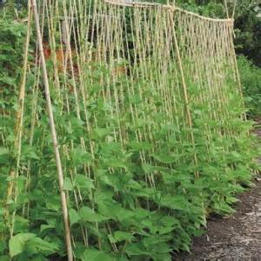
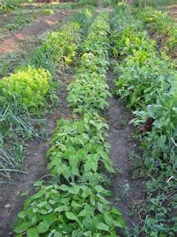
Growth habit, fruit shape
Determinate versus indeterminate tomatoes
Bush versus vining type cucumbers, bush versus pole beans
Plum, grape, cherry, and beefsteak tomatoes
Notes:
We have already discussed determinate versus indeterminate growth habit of tomato, but there are a number of other crops that have differences in growth habit. Pumpkins come in a number of growth habits, ranging from the more compact bush types to the ground-eating vining types. If you are limited in space, the bush-type may be more suitable to your needs. Beans and peas are similar in that there are free-standing bush types and climbing types available. The climbing types require some form of trellis and usually require more space.
Tomatoes are a good example for differences in fruit size. The bite size tomatoes, which include the currant, grape and cherry tomatoes can be extremely time consuming to harvest if you aren’t harvesting them in clusters. Once you get beyond bite size, tomato cultivars are available in every size class up to the beefsteaks which can weigh as much as 2 pounds per fruit. Most markets vary in the size of tomatoes clientele want—some can sell small tomatoes and some can’t give them away. The same can be said for beefsteaks. It is important to not invest significant inputs into one cultivar unless you are certain it is marketable.

Slide 18
Space
Indeterminate tomatoes must be trellised and will grow very tall.
Trellising
Vining
Canopy
In-row spacing
Between row spacing
Notes:
Regardless of whether you are growing in the field, a tunnel or a greenhouse, keep in mind your space limitations. Plants have a three dimensional space requirement; that if crowded by another plant or structure can greatly limit that plant’s quality and yield potential. Selecting the best cultivar for your space is the first step, but understand that there are more advanced techniques available to control plant size, like dwarfing rootstock, pruning and trellising to mention a few.

Slide 19
Yield
Overall yield
Early yield or consistent yield
Data in the Midwest Vegetable Variety Trial Reports …
https://ag.purdue.edu/hla/fruitveg/Lists/Midwest%20Vegetable%20Variety%20Trial%20Report%20Bulletins/AllItems.aspx
Notes:
Variety trial reports are a good way to become aware of early production reports on newly released or coming soon cultivars, but even better is to take that information and trial promising cultivars in your specific production system and growing conditions. With a little search on the web, a number of variety trial reports can be found for fruits and vegetables alike. Shown here is the link to the Midwest Vegetable Variety Trial Reports

Slide 20
Maturity
Sweet corn
Bi-color – Fastlane – 67 days
Bi-color – Ambrosia – 75 days
Bi-color – Providence – 82 days
Tomatoes
Peaches
Apples
Brambles
(all fruit and vegetable crops)
Notes:
Cultivars can vary greatly in their maturity dates. With many crops, cultivar selection across multiple maturity dates can be utilized for succession planting and harvest. Instead of making several successive plantings with the same cultivar, one plant date can be done with a range of maturity dates. For example, if there is sufficient market demand, there are enough fall apple cultivars to require harvest from late August to late November. A note of caution…days to harvest are usually based on where variety trials were conducted and may not necessarily come into harvest in the same number of days locally, especially if there is a zonal difference or unusual weather conditions.

Slide 21
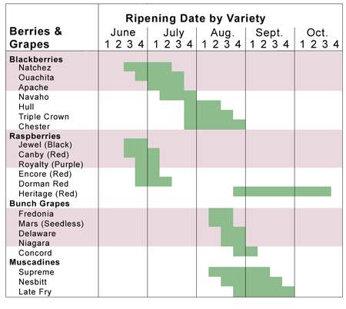
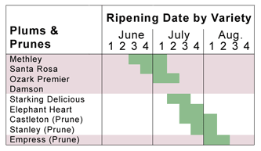
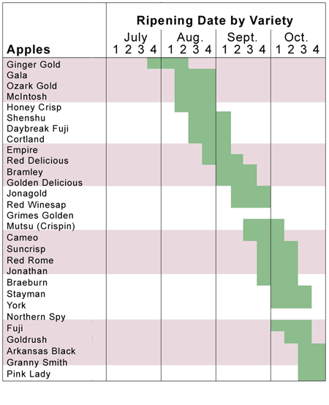
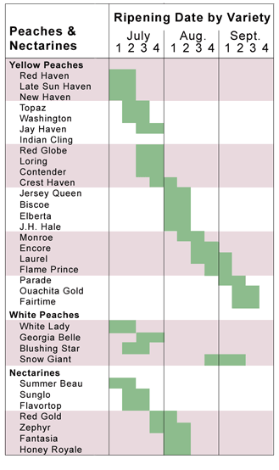
Perdue’s Mountain Fruit Farm, Taylors, SC
http://www.carolinafarmers.com/perdue/emails/2010/email2010-06-04.html
Notes:
Pictured here is one of many harvest maturity charts available on the web for apples, brambles, grapes, and stone fruits. By way of example on how harvest date can vary depending on where the date was collected, this data was for South Carolina and it shows ‘Jonagold’ apple ripening on or around the second week of September. If you were to look at the approximate harvest dates for south central Pennsylvania, a chart provided by Adams County Nursery, you would see Jonagold in harvest the first week of October—that’s a three week difference. The take home is to adjust accordingly for other locations and trial locally for more specific harvest dates. Continue to track harvest dates to better pinpoint sales availability.

Slide 22
http://www.acnursery.com/acn_apple.php
Notes:
This is the link to Adams County Nursery which was referenced in the previous slide. Adams County Nursery is just one of many reliable growers of fruit trees for Midwest growers.

Slide 23
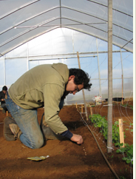
Accomplishing succession of harvests
Choosing varieties
Repeating plantings over time
Planting a range of cultivars with different maturity dates
Why? Allows for extended harvest and sales of product.
Planting the same cultivar periodically over the growing season
Planting a range of maturities at each planting rather than planting one maturity every 1-2 weeks (for instance) has less risk in outdoor production due to weather concerns.
Notes:
Succession planting has somewhat been mentioned in previous slides but the concept is important enough to further emphasize. The concept of succession planting is to plant in a manner that the crop trickles in as needed rather than all at once. Planting in this manner reduces the need for post harvest storage because the crop is harvested as needed if planted correctly. There are two ways to succession plant—over time or over maturity date of cultivars. Sweet corn is a good example of a crop that can be succession planted both ways. Let’s say your clientele has shown a decided preference for ‘Providence’ sweet corn. You can supply ‘Providence’ sweet corn throughout the season by planting blocks periodically over the growing season. Let’s say you clientele just likes bicolor, but not necessarily ‘Providence.’ Another method then is to plant multiple bicolor cultivars with different maturity dates so as each cultivar matures, you have sweet corn to harvest. For perennial fruit crops, it is standard to plant a number of cultivars with varying maturity dates to extend the harvest season.

Slide 24
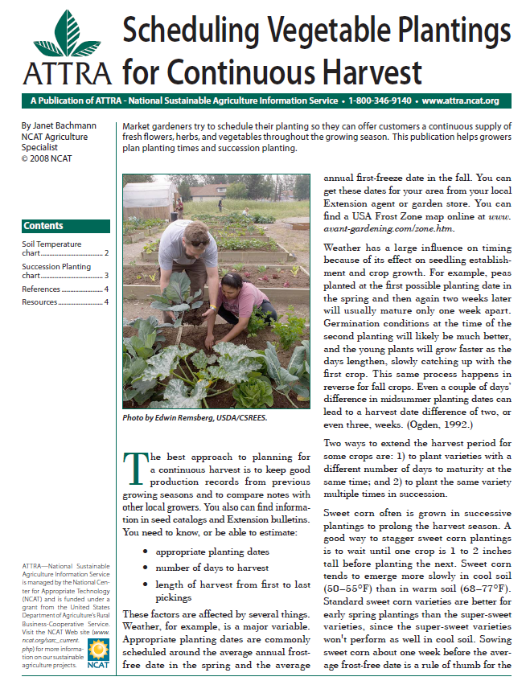
We have also provided Zack Grant’s spread sheets and the link to Ag-squared, as well as catalogs such as Johnny’s Select Seeds that provide guidance on planting schedules.
https://attra.ncat.org/attra-pub/summaries/summary.php?pub=20
Notes:
Presented here is a link to the one of the many fact sheets provided by Appropriate Technology Transfer For Rural Areas, also known as ATTRA. ATTRA is a sustainable agriculture information center that provides technical assistance to farmers, market gardeners and extension agents on farming topics by providing an on-line resource for sustainable agriculture and organic farming news, publications, events and funding opportunities.

Slide 25
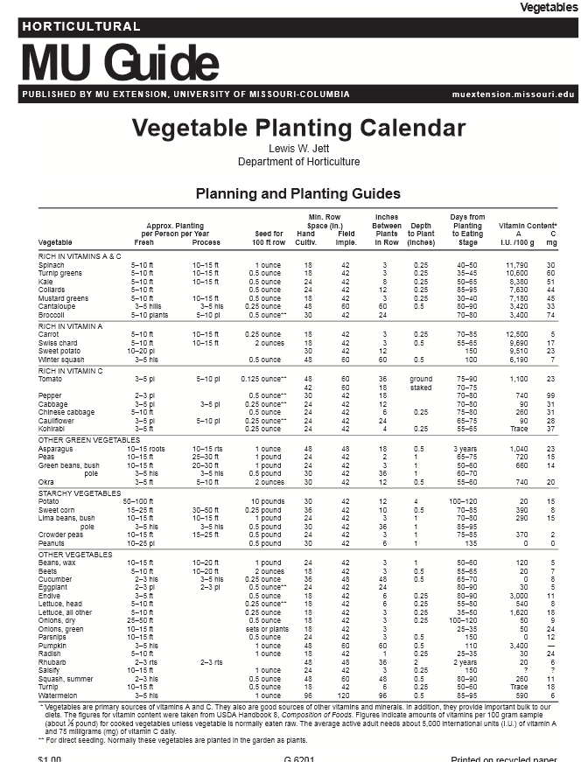
Couple variety-specific information with general guidelines on yield and maturity to plan plantings that meet market needs.
http://extension.missouri.edu/explorepdf/agguides/hort/g06201.pdf
Notes:
The pieces should be coming together. You have been introduced to the concept of cold hardiness and heat zones for determining whether a crop is suitable to your specific growing condition. You have also been introduced to cultivar specific performance data and harvest maturity data for selecting which specific cultivar is most suited to your specific growing conditions and marketing needs. Shown here is a fact sheet developed for Missouri vegetable growers on crop spacing, seed needs and some nutritional information. This is a good example of a fact sheet that contains very useful information to growers outside of the state it was intended for.

Slide 26
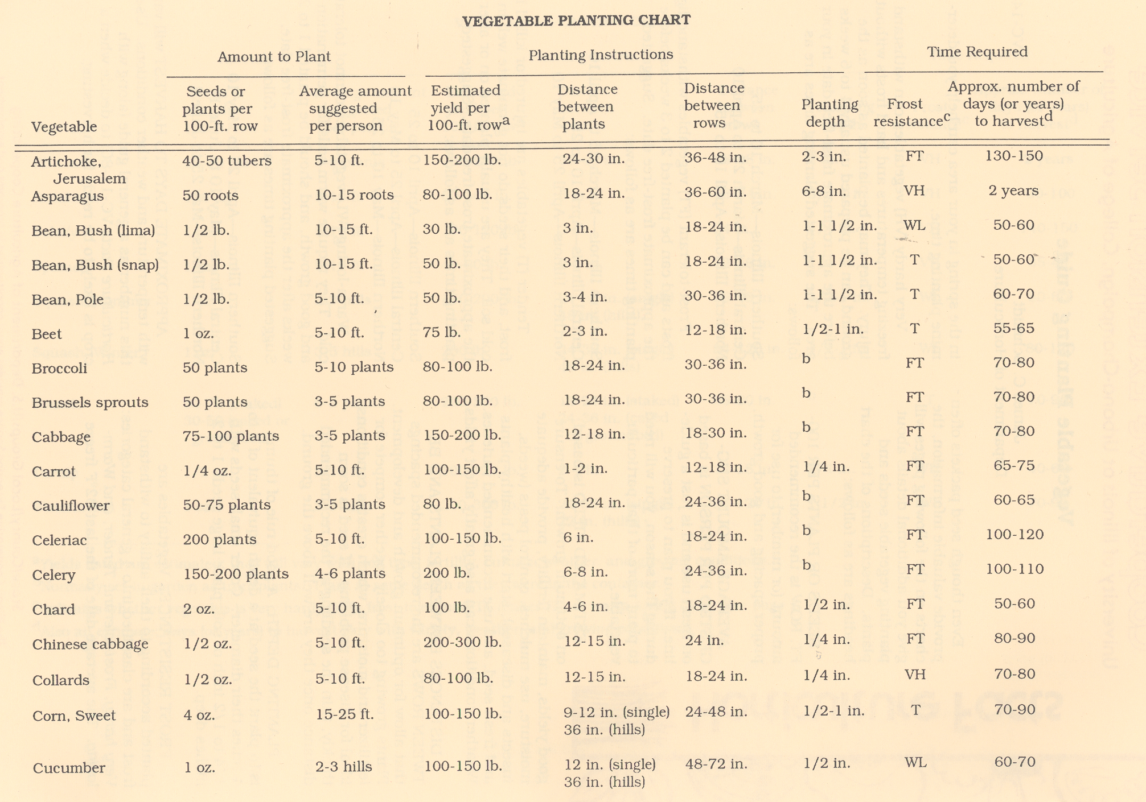
Notes:
Provided as a handout in its entirety is the Vegetable Planting Guide, a fact sheet providing information pertinent to planting each crop properly at the right time.

Slide 27
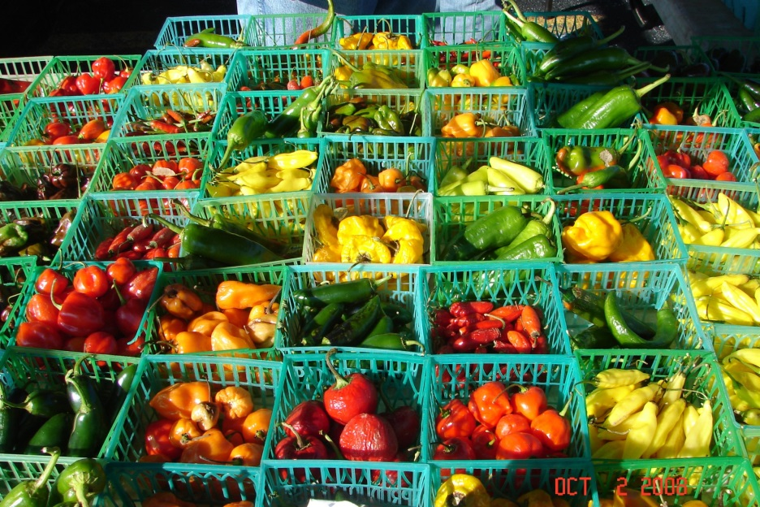
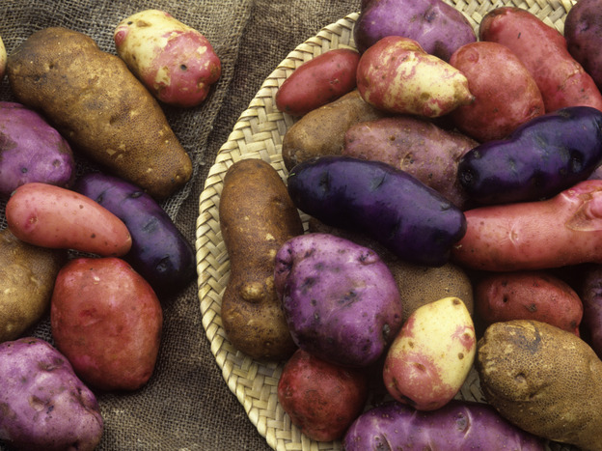
Color
What do your buyers want? What will attract them to your stall at the farmers’ market?
Golden Delicious versus Arkansas Black apples
Fruit colors of bell peppers
White, yellow, and bi-color sweet corns
Potatoes, carrots, etc.
Notes:
Color may bring the customer in, but taste and quality bring them back. Most fruit and vegetable crops come in a rainbow of colors; a trait that can be utilized to create an attractive and inviting market display. Maintain an active on-farm trialing program to provide customers with the best tasting and highest quality, but don’t forget to mix it up with color if your market has shown demand for color choices.

Slide 28
Flavor and nutritional value
Super-sweet & sugary-enhanced sweet corn
Tomato cultivars
Vidalia versus other onions (really?)
Antioxidants in different brambles and blueberries
Anti-cancer components of different broccoli cultivars
Notes:
Interest in the nutritional value of fruits and vegetables has been increasing, in part because of recent findings on the high level of obesity and other diet-related health problems in children and in part because of increased federal
support of programs funding consumption of fresh and processed fruit and vegetable products. Seed companies and nurseries have many offerings with elevated nutritional levels, like lycopene-rich tomatoes to lower stroke risk.

Slide 29
Disease and insect resistance
V, F, N designations in seed catalogs
Verticillium Wilt, Fusarium Wilt, Nematodes
But there are many more resistance designations (well over 100 crop-disease resistance designations in the 2013 Siegers catalog)
Resistance to one or more key diseases of apples
Stewart’s wilt resistance in sweet corn
Notes:
Growing cultivars with disease and insect resistance can reduce pesticide inputs and reduce risk of crop loss. The majority of pest resistant cultivars have been developed through traditional breeding programs and are accepted in all markets. Genetically modified organisms, as already mentioned, are not acceptable for certified organic production nor are they accepted in all markets. If your market accepts GMOs, cultivars are available in sweet corn and summer squash.
As an additional note, seed treatments are another option to protect crops. Seed treatments can provide both insect and disease protection. Conventional seed treatments are not permitted in certified organic production.

Slide 30
Post-harvest stability, quality
Shipping versus fresh-market sweet corn
Summer versus fall apples
Susceptibility to cold-injury in spinach
Although picking sooner or later affects post-harvest stability (think peaches or tomatoes), variety selection also influences post-harvest quality. Varieties best-suited to farmers’ markets often are not the same as those grown for sale to a local grocery store or for wholesale.
Notes:
Another selection criteria for a specific cultivar is its post-harvest quality—meaning how long can it be in storage or on the sales floor before becoming unsaleable. Another is how well it stands up to shipping. Thin-skinned or delicate cultivars have short shelf lives and do not ship well. One example already mentioned is ‘Cherokee Purple” tomato. “Cherokee Purple” is very thinned skinned and is difficult to harvest without bruising and is often harvested with gloves. It has a shorter shelf life than other tomatoes and does not ship well. Why grow it then? It has excellent flavor and if there is market demand, can fetch a premium price. Yellow raspberries are similar, but certain restaurants will pay a premium for the scarce yellow raspberry.
Good shippers tend to have more durable exteriors and maintain their quality in storage. Shrunken2 cultivars of sweet corn are a good example. Their kernels tend to be tougher and they stay sweet for a long time.

Slide 31
Market niche
Acceptable to consumer
Retailer
Wholesaler
Institution or restaurant …
Can you grow a cultivar at a density or spacing that aids in harvest AND satisfies the needs of the buyer? Can you do it profitably? (Remember, the market niche for a cultivar is not infinite in size … another growers’ success may or may not be an indicator that you can succeed by doing the same thing.)
Notes:
Capturing a niche market means providing a specific product for a specific aspect of the market. The market niche defines the product features aimed at satisfying specific market needs, as well as the price range, production quality and the demographics that is intended to impact. An example of a niche would be supplying ghost peppers to the hot-pepper market, or supplying baby greens to the restaurant market, or supplying fresh produce to local clientele.

Slide 32
Profitability
$$ per square foot or acre
Based on yield, price, and amount actually sold … minus input costs
Requires accurate record-keeping
Notes:
Maintaining budgets for each crop helps to allocate land, labor, and capital to the most appropriate use but they also provides information to the grower on whether a selected crop or cultivar is performing as expected. There are a number of enterprise budgets available on the web for a variety of crops.

Slide 33
Certified organic production?
Requirements for seed purchasing
The National Organic Program (NOP) (http://www.ams.usda.gov/AMSv1.0/NOPNationalOrganicProgramHome) requires crop and plant producers to use organic seeds, annual seedlings and planting stock within their operations unless they can verify that such sources do not exist.
Untreated seed is not the same as organic seed
Heirlooms to hybrids can be grown organically – or not
Notes:
In general, for organic crop production, the producer must use organically grown seeds, annual seedlings, and planting stock unless a cultivar is not commercially available. Regardless of availability organically produced seed must be used for the production of edible sprouts;
Non-organically produced planting stock to be used to produce a perennial crop may be sold, labeled, or represented as organically produced only after the planting stock has been maintained under a system of organic management for a period of no less than 1 year

Slide 34
Information on Cultivar Performance
Seed and plant stock catalogs, suppliers
Research reports
Extension programs
Other growers, farmers markets
Your experience and records
Notes:
Educate yourself. There are a number of sources for information about planting stock. Commercial catalogs are an excellent source of information, and research reports can provide unbiased information to support catalog claims. Make a point of attending programs for commercial growers; this is another excellent opportunity to interact with other growers and sales representatives. Visit other markets to see what other growers are producing and how crops are priced and displayed. Don’t discount your own experience and production records in making cultivar selections.

Slide 35
Study catalogs carefully
Great source of variety-specific information.
Companies spend a good deal of time and effort evaluating their varieties under specific conditions and provide valuable information.
For example, lettuce: leaf or head, cold or heat tolerant, high tunnel or field grown, organic, salad mix component, disease or insect resistance or susceptibility, grows well in containers …
Notes:
As already mentioned, commercial catalogs are a very good source of cultivar specific information. Many of the larger suppliers employ sales representative who will work with you of plant material selection. Most have a web presence to make contact with a representative.

Slide 36
Varietal evaluation
Midwest Vegetable Variety Trial Reports
Can be found online at: https://ag.purdue.edu/hla/fruitveg/Pages/MVVTRB.aspx
Created by Extension and University research stations from states across the Midwest.
Notes:
The Midwest Variety Trial Report was created by Extension and University research station from across the Midwest. The report comes out annually, showing results from the most recent vegetable cultivar trials.

Slide 37
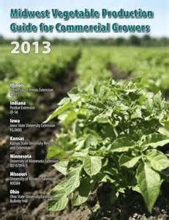
http://www.btny.purdue.edu/pubs/id/id-56/ID-56.pdf
The annual Midwest Vegetable Production Guide for Commercial Growers includes listings of several varieties suitable for commercial production … but it is not all-inclusive.
Notes:
The Midwest Vegetable Production Guide primarily provides pesticide recommendations, but also includes a limited cultivar recommendation for each vegetable crop and basic production information. The guide is updated annual is availlable as a hard copy from your local Extension office or it may be viewed online at the address given here.

Slide 38
Apple and Peach Cultivars and Rootstocks
Rootstocks determine size and (to some extent) disease resistance
Disease-resistant cultivars allow minimal fungicide use (see http://www.ca.uky.edu/agc/pubs/id/id93/intro.pdf and http://www.extension.purdue.edu/extmedia/BP/BP-132-W.pdf, as well as nursery catalogs)
Different cultivars provide harvests over a range of several weeks … see nursery catalogs
Notes:
As mentioned in the “Basic Fruit Production” module, cultivar and rootstock selection is just as important in fruit crops as it is in vegetable crops. Cultivars and rootstocks differ in their cold hardiness, tolerance to heat, wet soils and pests. The nursery sales representative is an excellent source of information when choosing rootstocks or cultivars.
Cultivars vary greatly in harvest date. Careful selection of cultivars results in a successful succession harvest, with no gaps or over-abundance of crop.

Slide 39
Apple rootstocks: http://www.acnursery.com/rootstock.php
(also see other nursery lists and references)
Notes:
On the web, abundant information is available on rootstocks, but keep in mind that nurseries don’t grow all of them. You have been told that you can’t grow everything…well, nurseries follow the same rule. Do your research, then compare that information with what the nursery has available. You may not be able to get what you want immediately…a 1-2 year wait is quite common with fruit tree orders…so plan ahead.

Slide 40
Strawberries
June bearing - traditional strawberry matted row production, harvested in May/June time frame. Wide range of maturities could allow extended harvest of 5-6 weeks or more
Everbearing - harvest fluctuates throughout year, from individual plants not allowed to runner, until frost ends season. Very similar total yields to June bearing
Plasticulture - higher management system, berries planted in the fall on raised plastic beds, harvest the next season, beginning several weeks earlier than June bearing plantings
High-tunnel production … what varieties are best suited?
Notes:
The next few slides are crop specific and demonstrate the choices that need to be made before you even start selecting cultivars. When do you want strawberries? If you want just one crop per year, then you want to look at production systems for June-bearing types. If you want more than one crop throughout the year, you will want to look at production systems for ever-bearing strawberries. There are several production systems suited for field, high tunnel or greenhouse production and each have recommended cultivars. For example, cultivars recommended for plasticulture production are better suited because they have longer petioles.

Slide 41
Sweet Corn
Many types of sweet corn, varying in sugar/starch content, insect and herbicide tolerance, maturity, color, etc.
Standard, sugary enhanced (SE), shrunken (SH2), and combinations
Yellow, white, bicolor
GMO traited - Attribute insect protection, Performance insect/herbicide protection
Consider resistance to Stewart’s wilt (bacterial disease transmitted by corn flea beetles)
To prevent starchy, tough kernels, isolate supersweets (SH2) from SE types by at least 100 ft. in commercial plantings or by a 10-day difference in silking dates.
Notes:
The first sweet corn cultivars were Sugary types, designated as SU. They have all but fallen out of the market because they loose their sweetness rapidly after harvest. Today the most common types of sweet corn are the sugary enhanced, shrunken 2 types, and combinations between the two. Sugary Enhanced types, designated SE, have improved sugar retention, a tender, creamy kernel and excellent flavor. Shrunken types, designated as SH2, are very sweet without loss of sweetness over time and are excellent for shipping. There are also GMO sweet corn cultivars available with the Bt trait for resistance against corn earworm and armyworm. There are cultivars available carrying the trait for herbicide resistance as well.
There are a few rules specific to sweet corn when planting multiple cultivars. All sweet corn must be isolated from other types of corn to some degree or they loose their desired flavor characteristics and instead taste starchy. White cultivars will develop yellow kernel if pollinated by a yellow type. To avoid these pollination errors, separate by a distance of at least 100 feet or planting date of at least 10 days.

Slide 42
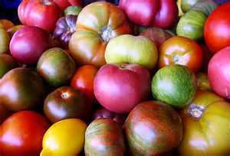
Tomatoes
Wide range of maturities, color, sizes, acidity, etc.
Heirloom (open pollinated)
Hybrid
Globe (round), beefsteak (large), cherry, Roma, pear, plum, grape
Consider disease resistance (V,F,N, … and more)
Notes:
Tomato has been used as an example a few times, so you already know that there is a huge number of cultivars available to choose from. The newer hybrids have been bred with resistance to Fusarium Wilt and Verticillium Wilt, but many of the heirloom cultivars are susceptible to these soil borne diseases. For heirlooms, grafting to a resistant rootstock would be recommended if either disease is an issue.

Slide 43
Evaluating plant performance on your farm … observe and record
Germination
Plant stand
Insect and disease occurrence
Dates of harvest
Yield by date
Percent culls
Market price, total sales, unsold compost
Notes:
As mentioned before, make a practice of maintaining an active cultivar trialing program on your farm. Variety trail reports tell you how the cultivar performed at the research location, not your farm. This also allows you to produce a small amount to test on your market for customer acceptance. Trials should be planted and maintained just as the main production area, so they are treated equal. In a trial, you should maintain records on stand count, date harvest started, marketable yield, percent culls, and any problematic pest issues. Once harvested, take note of clientele acceptance in terms of total sales. If the customer won’t buy the product, there is no point in utilizing resources to grow it.

Slide 44
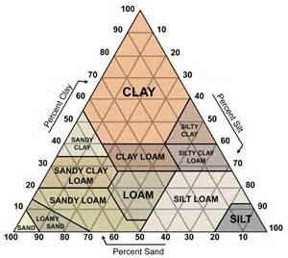
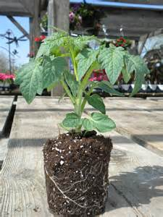
Consider cultural practices when choosing crops, varieties, and cultivars.
Location, including drainage
Soil types: pH, sandy soil, clay soil, loamy soil
Layout of site
Rotation
Planting method – direct seed or transplant
Pest management
Notes:
When selecting cultivars, keep in mind that rotating crop families is a good way to reduce pest occurrences. Crop families refers to relatives within the same plant family. For example, within the Solanaceous or tomato family, tomato, pepper, potato, tobacco, husk tomatoes and eggplant are all closely related and share similar pest issues. In a proper rotation, a member of the same family would never follow another member in the rotation. A crop from a different family should follow in the rotation—say the onion family or the cole crop family. Crop rotation is usually associated with annual crops, but rotation is employed in perennial crops as well, the rotation just doesn’t happen as often. Because of replant issues, apple don’t usually follow apple and peaches don’t usually follow peaches.
Some crops are better started as transplants. Commonly transplanted are members of the tomato family, cole crops and many vine crops. Keep in mind production space and time needed for transplant prior to field planting.
Soil types are more suited to some crops than others. For example, carrots are not suited to heavy clay soils. The carrots will grow, but the roots tend to fork and become knobby in heavy soils. They are better suited to lighter soils. Brambles in general require uniformly moist soil at all time, so sandy soils are more risky without an installed irrigation system. Roostocks for tree fruit have varying susceptibility to soil borne diseases, so care should be taken when selecting rootstock for heavy clay soil. Full dwarf apple rootstock have a very limited root system, and like brambles are not as suited to light soils unless irrigation is installed.

Slide 45
Resources
Seed and nursery catalogs
Seed suppliers include Johnny’s, Siegers, Seedway, Rispens, Rupp, Stokes, and more
Fruit nurseries include Stark’s, Adams County, Moser Fruit Tree Sales (including Grandpa’s Orchard), Raintree, Van Well, Cummins, Nourse, Indiana Berry, and more
Notes:
Most seed and nursery stock suppliers maintain a web presence, where you can order a catalog or place an order. Another good way to make contact with suppliers is to attend specialty crop program trade shows, which are all held throughout December through February.

Slide 46
To reach us
Contacts | Contact information
Jeff Kindhart | jkindhar@illinois.edu
Elizabeth Wahle Kyle Cecil | wahle@illinois.edu cecil@illinois.edu
Mike Roegge | roeggem@illinois.edu
Rick Weinzierl | weinzier@illinois.edu
Notes:
Listed here are contacts at University of Illinois Extension should you have additional questions related to cultivar selection.

Slide 47
If you have questions …
University of Illinois Extension Local Food Systems and Small Farms team
http://web.extension.illinois.edu/smallfarm/
USDA’s Start2Farm site
http://www.start2farm.gov/
Notes:
Our beginning farmer training program ended in the fall of 2015. The best way to pursue answers to questions about fruit and vegetable production in Illinois is to contact educators on the University of Illinois Extension Local Food Systems and Small Farms team. Extension programs in other states are operated by the land-grant university in each state. Additionally, USDA’s Start2Farm site provides listings of farmer training programs in specific states and localities.

